Slide 1
Principal Components Analysis
Part 2

Slide 2
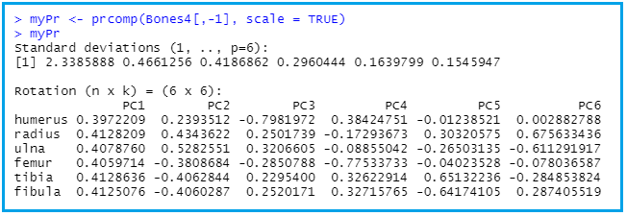
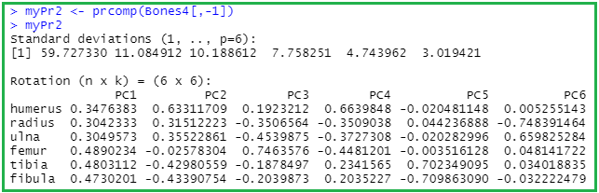
Principal Components Analysis (PCA) Recall from last presentation

Slide 3
Recall
Principal Components Analysis (PCA) is a data reduction technique that can be used to transform a larger number of correlated variables into a much smaller set of uncorrelated variables called principal components.
Variables are quantitative predictor variables.
In the case of the Bones data, the data from 6 long bones predictor variables are highly correlated. We want to use PCA to transform them into a smaller number of uncorrelated composite variables that retain as much information as possible from the original variables.
The composite variables are linear combinations of the original variables (or standardized version of the original variables)

Slide 4
More on PCA
The components: PC1, PC2, . . . , PC6. In theory, you can have as many components as there are variables. Since there are 6 long bones, we can extract up to 6 components.
PC1 will be a linear combination of the 6 bone lengths that account for the most variance in the original set of vectors.
PC2 will be a linear combination of the 6 bone lengths that account for the most variance in the original variables, under the constraint that it is orthogonal (uncorrelated) to PC1
And so forth.
Each component is associated with an eigenvalue of the correlation matrix.PC1 is associated with the largest eigenvalue, PC2 with the second largest eigenvalue, etc.
You can decide which components to retain based on the eigenvalues.

Slide 5
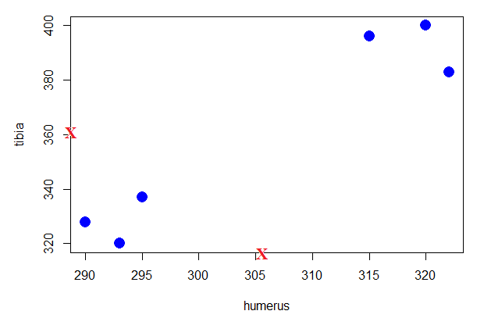
Scatterplot of tibia vs humerus (work toward creating a new coordinate system)
Mean humerus =
305.6667
Mean tibia=
360.1667
Transform so this becomes (0,0)

Slide 6
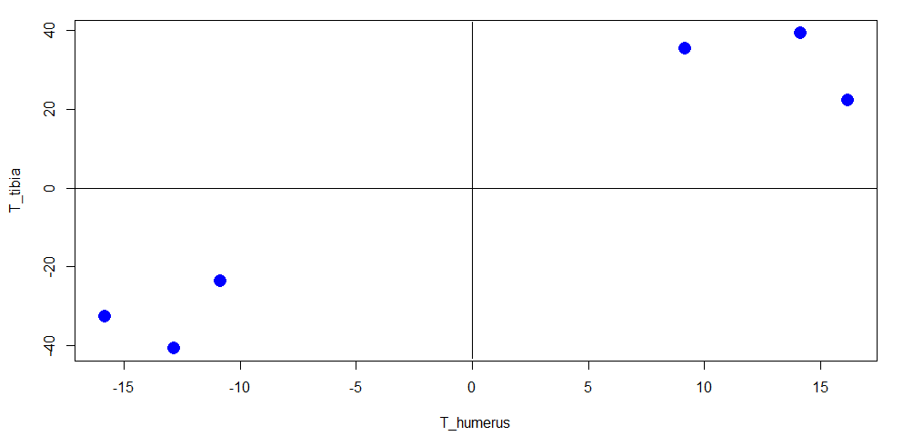
Transformed data (recentered)

Slide 7
Draw random line and rotate until best fits data; Want line on which projections of data points are most spread out; Capturing the most variability of the data.

Slide 8
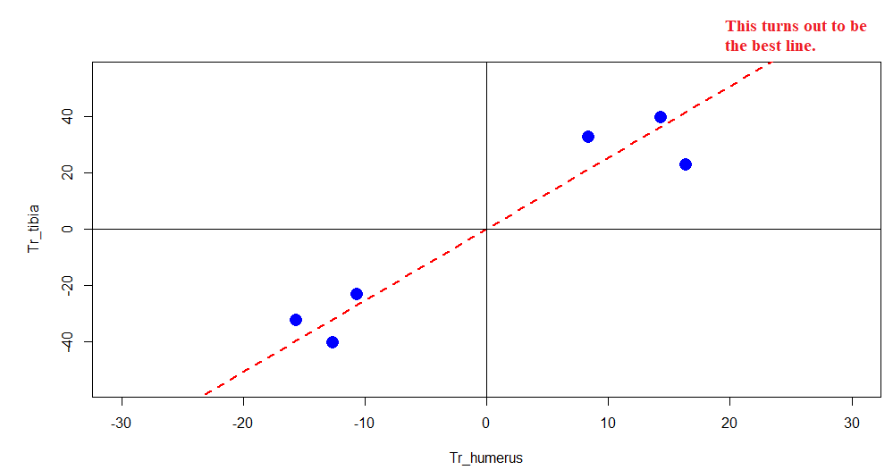
We will return to this after we
discuss the criterion for a best
fitting line.

Slide 9
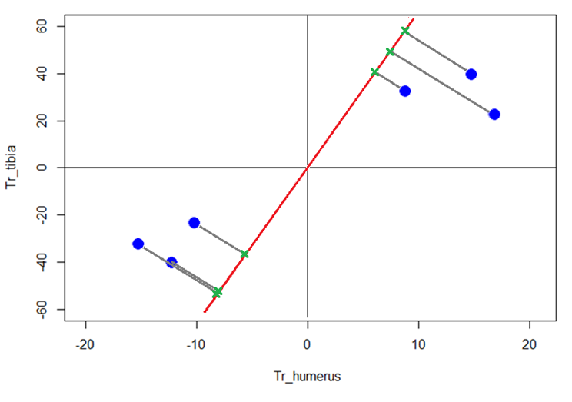
Take a random line through the origin; project data points onto the line
Find line that:
Minimizes distances from data points to projection points
Maximizes distances from projection points to origin

Slide 10
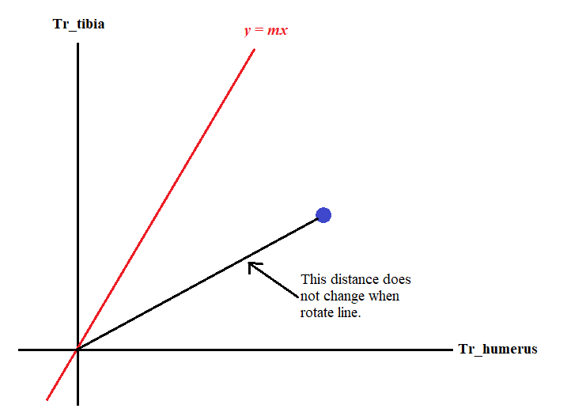
a² = b² + c²
Projection
b
Project point onto red line
Distance projection
to origin
c
It turns out that it’s
easier to calculate c
a

Slide 11
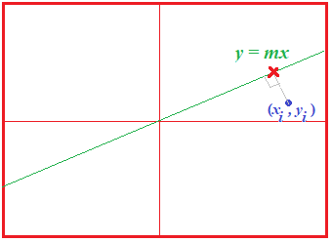

Criterion for best line: Maximize the sum of the squared distances between projection points and origin.
Find value of m that maximizes d₁² + d₂²+ d₃² + d₄² + d₅² + d₆²
Here’s how. Start with transformed data:
Step 1: Find equation of line through blue data
point that is perpendicular to the green line.
The slope gray line is -1/m.
Step 2: Find the intersection between gray line and
green line. That’s the projection point X.
Step 3: Find the squared distance between
projection point and the origin. (Next slide.)

Slide 12

Expression for SS(distances) – sum of the squared distances
Squared distance from projection point to origin:
Find m that maximizes the sum of the squared distances. For this I used Maple.

Slide 13
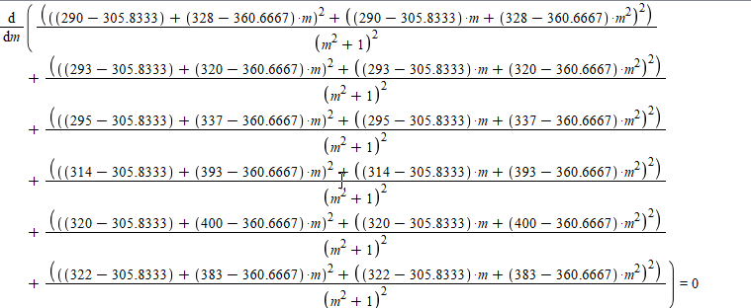

Maple Output

Slide 14
y = 2.537436319x
PC1

Slide 15
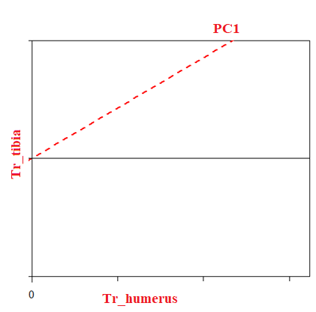
Slope PC1: 2.537436319
For each 1 unit we go along Tr_humerus,
we go up 2.537436319 units along Tr_tibia.
That means that the data are mostly spread out
along the Tr_tibia axis and less spread out along the
Tr_humerus axis.
2.5374
1
Think of PC1 as 2.54 parts tibia and 1 part humerus.
Tibia is more important when it comes to describing how the
data are spread out.
Squared length of purple vector:
1² + 2.537436319²
= 7.438583073
Length of purple vector is 2.727376592
When you do PCA with SVD (singular value decomposition), we need to scale the purple vector so that it has
Length = 1 (unit vector). So, divide the lengths of the other vectors by 2.727376592.
Green: 0.3666527032
Blue: 0.9303578855

Slide 16
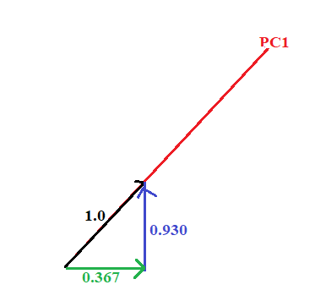
Eigenvector for PC1
The unit vector running in the direction of the best fit line is the eigenvector for PC1. The proportions of each variable (humerus and tibia) are called Loading Scores.
SS(distances) for best fit line: Eigenvalue for PC1 (next slide)
Eigenvector for PC1

Slide 17
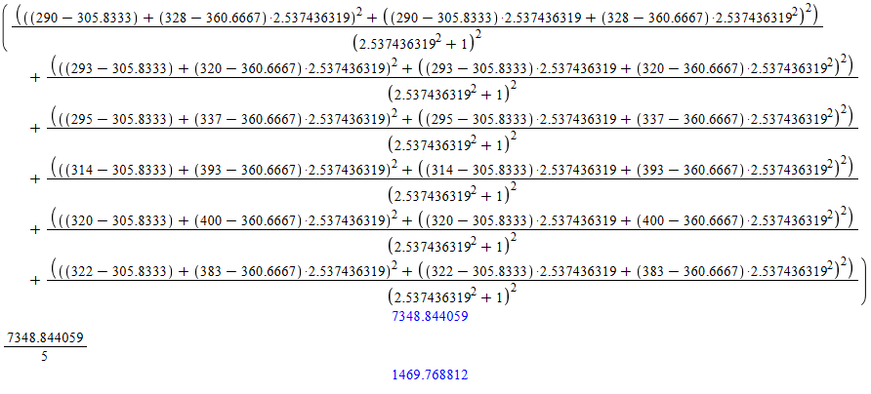
SS(distance)

Slide 18
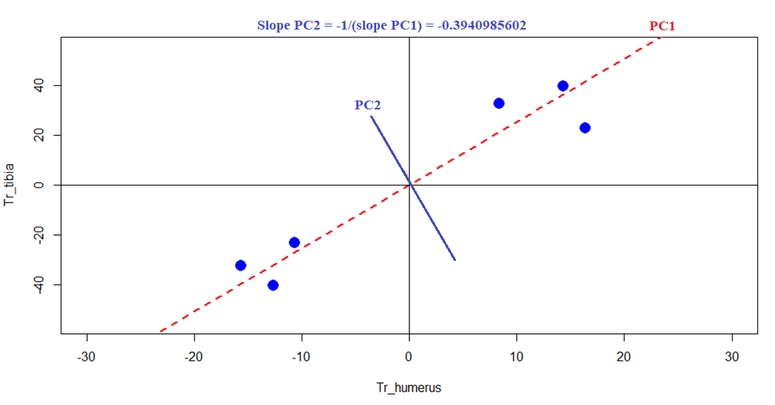
Next, work on PC2
Because we only have 2 vectors in this simplified case, we can only have PC1 and PC2.

Slide 19
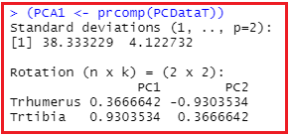
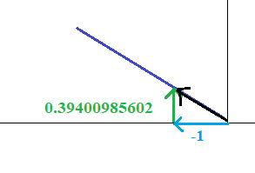
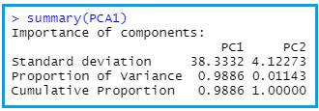
Go through same process to find eigenvector for PC2 and eigenvalue.
How do you get the equations for PC1 and PC2?
Go back to Slide 18:
Variance PC1 = 1469.77
Take sqrt to get 38.3, the
standard deviation for PC1.

